Slide 1

Image and Video Analytics - CA620
Assignment presentation
Shubham
Department of Computer Applications
M.Tech - Data Analytics(2020-2022)
Roll No. - 205220023
National Institute of Technology, Tiruchirappalli

Slide 2
Outline
Problem description
Dataset
Image Enhancement Techniques used
Object Detection and Classification Techniques used
References

Slide 3
Problem Description
Propose your own methodology based on intensity transformation techniques either in spatial domain or frequency domain or hybrid techniques and apply on the given datasets to produce quality images. Marks will be awarded based on the quality of images.
Design your own object classification model based CNN (Note: use datasets generated from problem 1). But,if you do both object detection and classification, good grade will be awarded.

Slide 4
Dataset
Dataset contains 291 frames taken from a cctv footage.
Image contains 3 channels.
Dimensions of each frame is 640*360.

Slide 5
Image Enhancement Techniques
Image Enhancement Techniques fall under two broad categories:
Spatial Domain Technique
Work on Image Plane itself
Direct Manipulation of pixels in an image
Frequency Domain Technique
Modify Fourier Transform Coefficients of an image.
Take inverse Fourier Transform of the modified coefficients to obtain the enhanced image.
Processing Techniques are very much Problem Oriented.

Slide 6
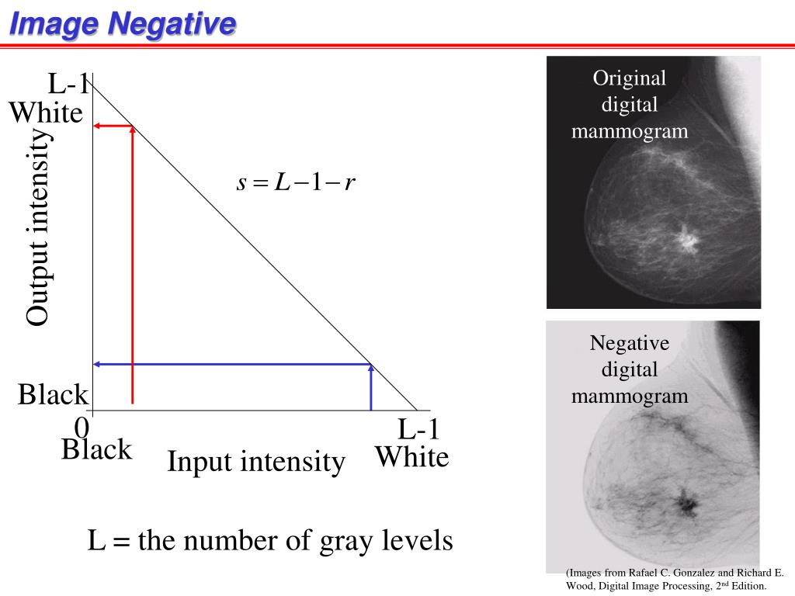
Image Negative
To just get a taste of pixel manipulation across different channels, Negatives of images were formed.
Image negatives can be obtained by subtracting each pixel value with Number of intensity levels present in image minus 1.
Transformation Function:
S = T(r) = L - r - 1

Slide 7
Contrast Stretching
When we are given a image having L intensity levels but intensity present in image have limited range. Contrast Stretching stretch those intensities to cover all levels available.
Contrast Stretching function is monotonically increasing.
Contrast stretching increases contrast of image by making darker pixels darker and vice versa.
Transformation Function:
New_intensity = (pixel_intensity - min)*(new_max - new_min)/ (max - min) + min

Slide 8
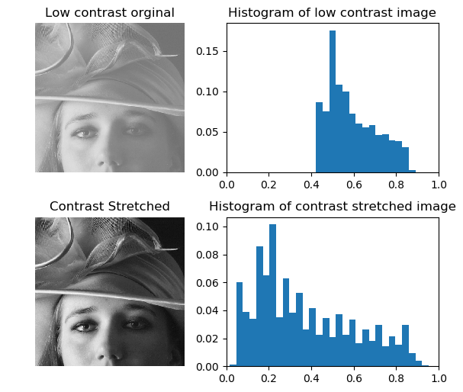
Contrast Stretching

Slide 9
Logarithmic Transformation
When we have image which has very high number of intensity levels. Pixels with with highest intensity supersede those with low intensity.
When dynamic range of device is very high, we use dynamic range compression.
Transformation Function:
S = T(r) = C*log(1+|r|)

Slide 10
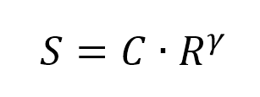
Power Law Transformation - gamma Correction
Generally we do gamma correction for images in CRT devices.
Also, Can be used for image enhancements.
Lower gamma(i.e <1) scales darker pixels rapidly and lighter pixels slowly and vice versa for higher gamma.
Transform function:
S = T(r) = C*r^𝛾

Slide 11
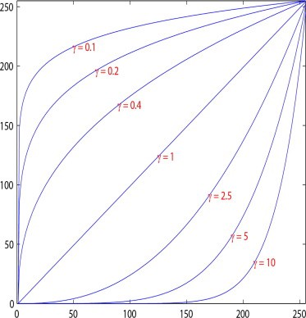
Gamma Correction

Slide 12
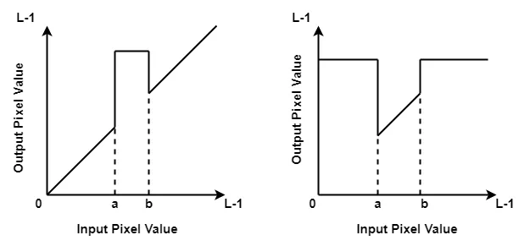
Gray - Level Slicing
For the desired intensity levels, image may be enhanced. For rest of the image we may suppress the image or keep it as it is.
Choice of enhancement function depends problem statement.

Slide 13
Histogram Equalization
Histogram equalization is a method in image processing of contrast adjustment using the image's histogram.
It is done in order to increase the contrast of image.
It makes the image more detailed as pixels are illuminated with all available intensity values.
Steps:
Calculate PDF for each intensity value.
Calculate CDF for each intensity value.
New intensity = CDF of that intensity * (L-1)

Slide 14
Image enhancement used for our dataset
A combination of Histogram equalization and gray level slicing gamma correction is being used in our assignment.
Histogram equalization is performed in our dataset and the output image produced is passed through a gamma correction filter to get the final output.

